Slide 1



Powered by McStas technology
"McXtrace: a Monte Carlo software package for simulating X-ray optics, beamlines and experiments", Journal of Applied Crystallography, vol. 46, part 3, June 2013
Peter Willendrup <pkwi@fysik.dtu.dk>
Emmanuel Farhi <emmanuel.farhi@synchrotron-soleil.fr> (and Erik Bergbäck Knudsen)

Slide 2
Outline
McXtrace introduction
New features of v. 1.4 taken from simulation of DanMAX
Other new features

Slide 3
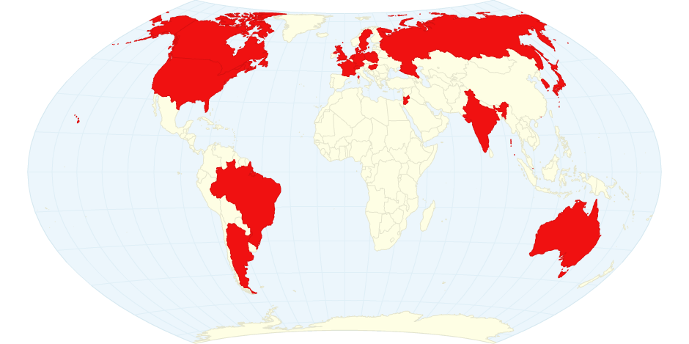











Where?

Slide 4
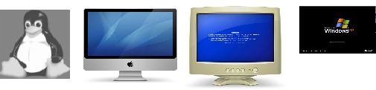
What is it?
Built on proven base of McStas for neutron ray tracing
K. Lefmann and K. Nielsen, Neutron News 10, 20, (1999).
This is Monte-Carlo: we use random numbers to describe particle distributions
Releases 1.7 and 3.0 (GPU support)
Portable code (Unix/Linux/Mac/Windows, 32 and 64 bit support)
Has run on all from iPhone to FERMI (world no. 7)
GPL-license
DSL / Compiler Technology.
Using Lex & Yacc
Modular Open Structure.
Components/devices written in structured ISO-c automatically fits in the system
Dependencies: c-compiler (python3/qt5 or perl/tk for gui).
Permanent staff at DTU Physics and SOLEIL maintaining the code
Project website at
http://www.mcxtrace.org
Project mailing list at
mcxtrace-users@mcxtrace.org
Source code at
https://github.com/McStasMcXtrace/McCode

Slide 5
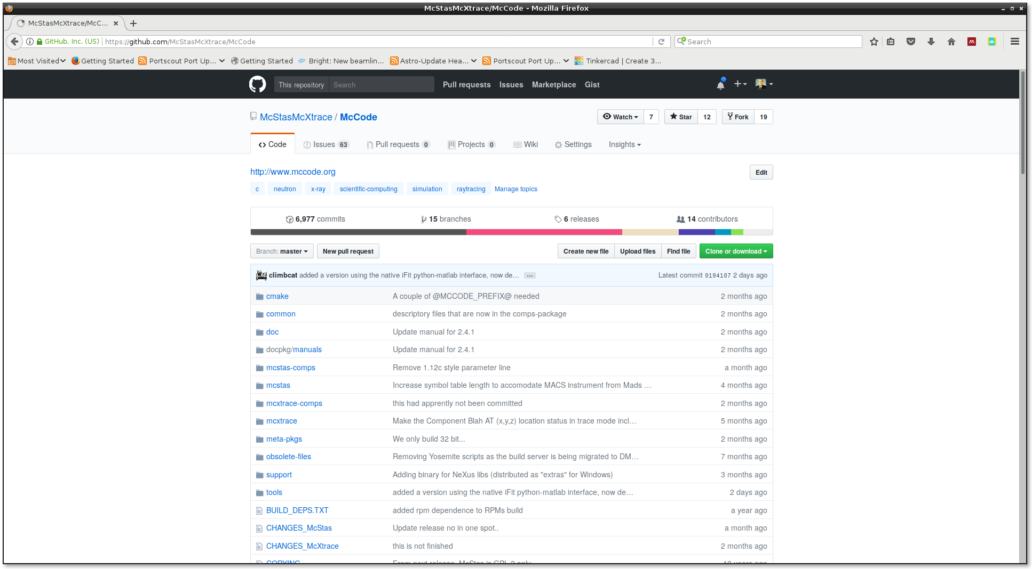
Github

Slide 6
Feature History - and plans for NG (not fully up-to-date)

Slide 7
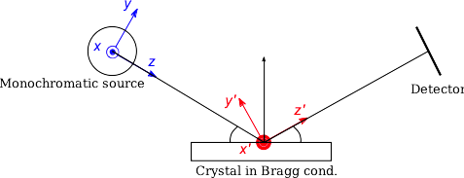
How?
Photon ray/package:
(r,k,φ,t,p,E)
r - spatial coordinates
k - wave vector
φ - phase
t - time
p – photon weight
E - Electrical field polarisation

Slide 8
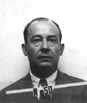
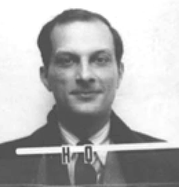
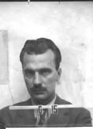
Monte Carlo techniques
During WW2, “numerical experiments” were applied at Los Alamos for solving mathematical complications of computing fission, criticality, neutronics, hydrodynamics, thermonuclear detonation etc.
Notable fathers: John v. Neumann Stanislav Ulam Nicholas Metropolis
Named “Monte Carlo” after Ulam’s fathers frequent visits to the Monte Carlo casino in Las Vegas
Initially “implemented” by letting large numbers of women use tabularized random numbers and hand calculators for individual particle calculations
Later, analogue and digital computing devices were used

Slide 9
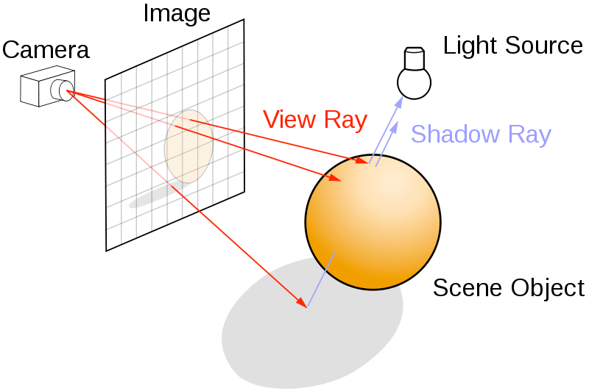
Ray-tracing methods
When particles move in “free space”, we use ray-tracing - but in most cases in direction source -> detector

Slide 10
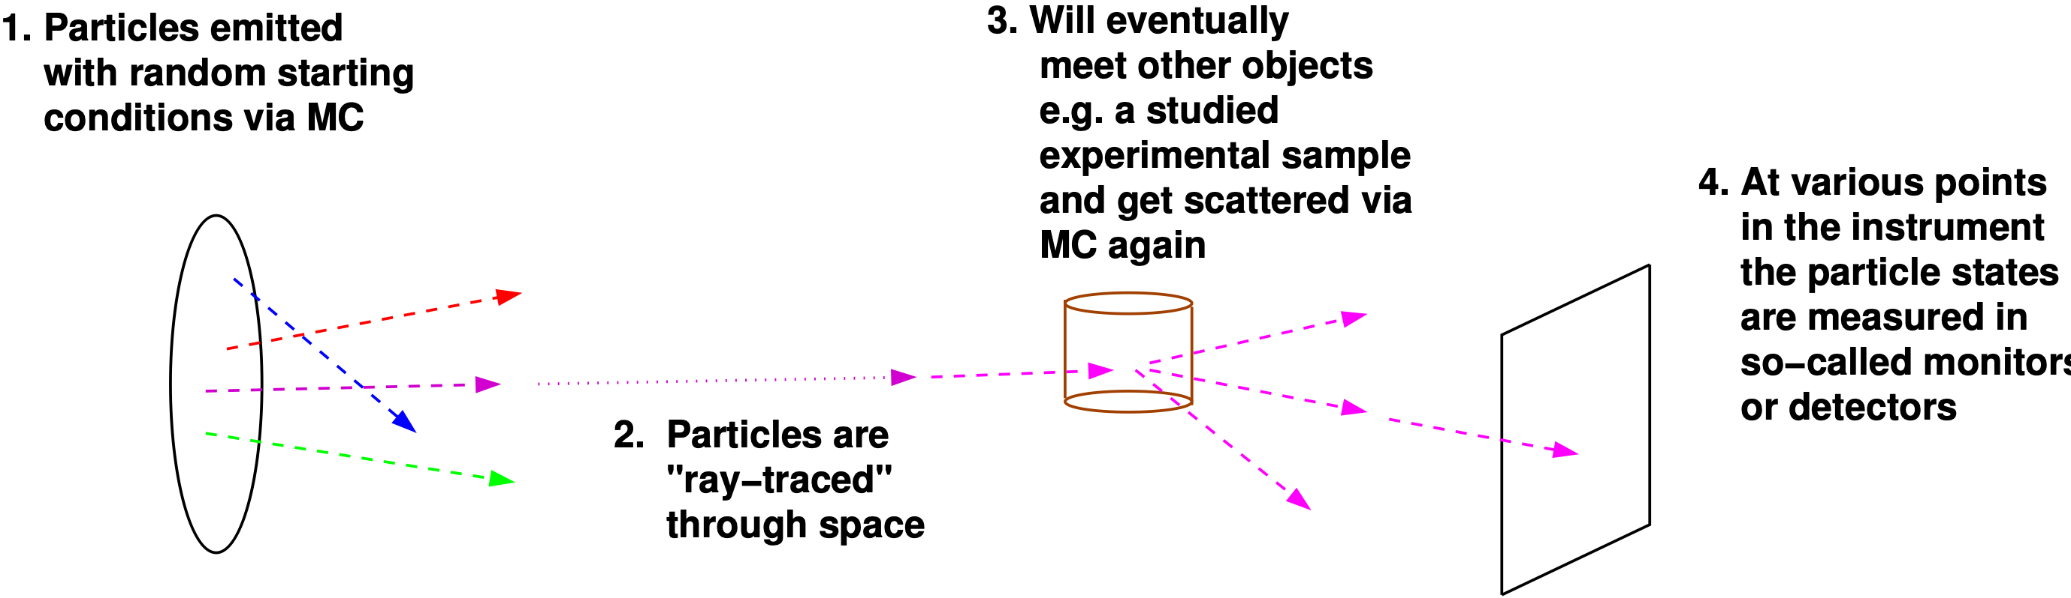
Overall picture: Monte Carlo Ray-Tracing
Important efficiency mechanisms:
“Focusing” - e.g. lab source to first slit (4π vs. limited solid angle only)
Rather vs. single particle description, absorption handled though statistics and downscaling the ray weight

Slide 11
The McXtrace way
Describe your beamline in the McXtrace language (In a text file).
Automatically convert beamline into ANSI c
Compile
Run
1.Optimized for your platform
2.Only includes what you use

Slide 12








Code Levels
Instrument file – all users
existing examples
user written – GUI assisted
Component files – some users
Short pieces of code
Easy to modify from existing
Kernel code – McXtrace developers
Propagation routines
Intersections
Generated ISO-C code – “no” users
Assembled by code generation
Very low overhead of unneeded code
Includes runtime libs that comps rely on (propagation etc.)
Instrument file (average user, point/click, DSL)
Component (advanced user, modify from existing, c-code)
Kernel (McXtrace team)

Slide 13
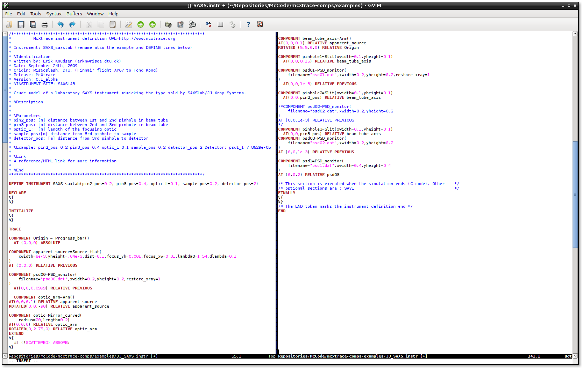
Instrument file (beam-line)

Slide 14
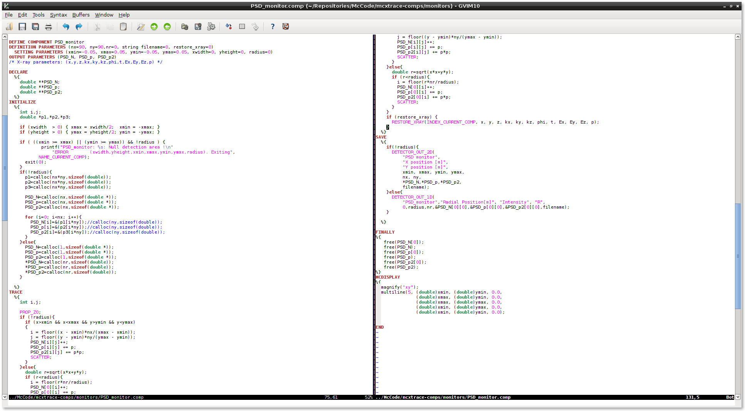
Component file (source, optics, sample, detectors, ...)

Slide 15
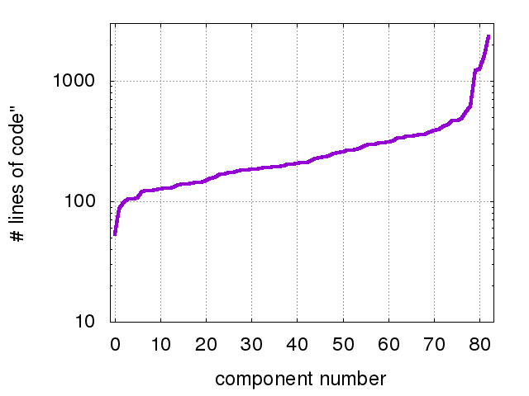
Component size: typically 100-200 LOC
Single_crystal
SasView_model
PSD_monitor
PowderN
Undulator

Slide 16
Why bother?
Why simulate when you can just do the experiment?
Why McXtrace and not sim. package X?

Slide 17
Why simulate a full beam-line?
Users don’t have the luxury you have!
Prospective users may try out experiments.
Teach users how to do experiments.
Understand what is happening along the beam-line.

Slide 18
Why McXtrace
Community driven code
Fairly easy to extend – write a new component and it automatically fits into the framework.
Portable (just need a c-compiler).
Several included standard sample models.
Plenty of examples.
Once written, a simulation/beam-line is a real program in itself.
...but...
Use whatever you prefer! XRT, SHADOW, SRW, Ray,...<insert package here>…

